Slide 1


Smart Verify
Transforming Student Exam Hall Ticket Validation through AI and Face Detection Technology

Slide 2
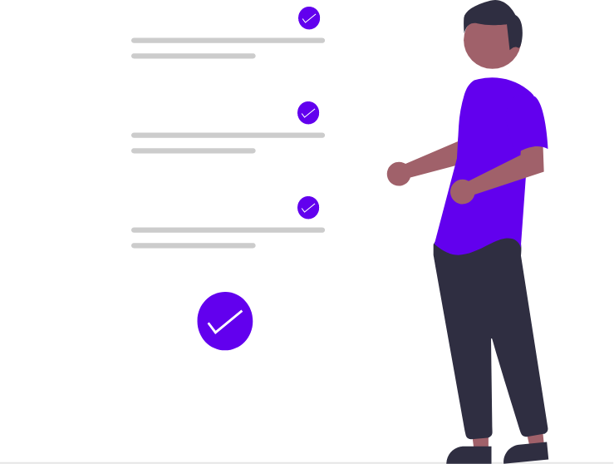
Agenda
Introduction
Project Overview
Problem Statement
Existing System
Proposed System
System Architecture
Technology Stack
Advantages
Implementation Details
Demonstration
Conclusion
Q&A

Slide 3
Introduction
Overview of the project
Our project, SmartVerify, revolutionizes exam hall ticket verification through advanced AI. By using face detection technology, we simplify exam processes, eliminating physical documents.
Importance
SmartVerify addresses challenges of traditional verification, streamlining exams and enhancing security. Students can focus on exams without worrying about misplaced documents.
Objectives
Digitize verification, streamlining exams.
Enhance security, reducing fraud.
Improve accessibility, eliminating physical documents.
Simplify administrative tasks.
Ensure a smooth exam experience.

Slide 4



Problem Statement
Many exam halls rely on manual verification methods, leading to inefficiencies and security risks. Students often face challenges with misplaced or forgotten physical hall tickets, hindering their ability to take exams smoothly.
Manual verification processes are time-consuming and prone to errors
Students may forget or misplace physical hall tickets, causing stress and inconvenience.
Traditional methods lack robust security measures, leaving exams vulnerable to fraud and impersonation.

Slide 5
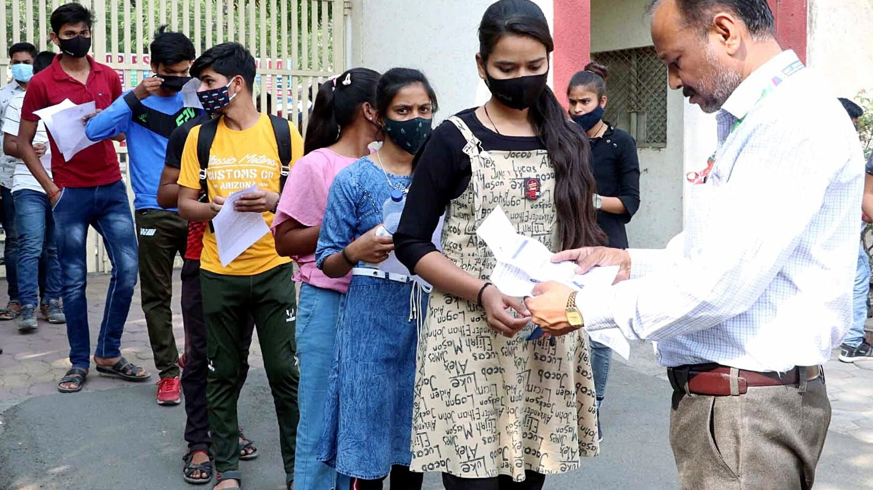

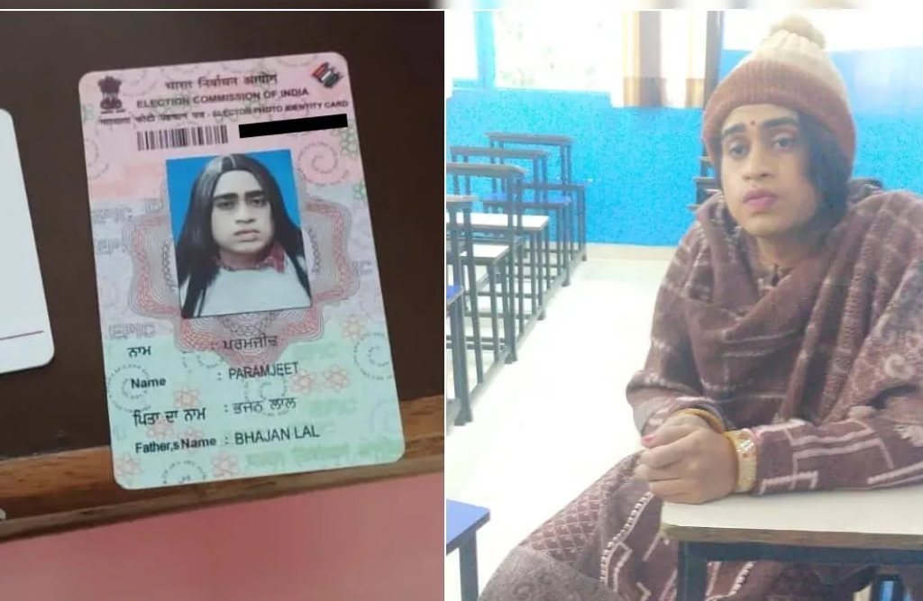
Existing System
Current exam verification relies on manual checking of physical documents.
Students must carry physical hall tickets and ID proofs, leading to potential issues with forgetfulness or misplacement.
Traditional methods lack efficiency and may result in administrative burdens and security risks.

Slide 6

Proposed System
Our proposed system, SmartVerify, introduces a digital solution for exam hall ticket verification. By leveraging AI and face detection technology, we streamline the process, ensuring a secure and efficient examination experience for both students and administrators.
Features
Digital verification of student identities using face detection technology.
Elimination of the need for physical hall tickets and ID proofs.
Enhanced security measures to prevent fraud and impersonation during exams.

Slide 7
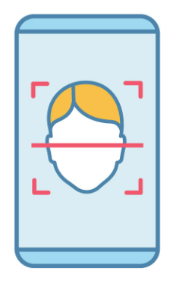
System Architecture
Face Detection & Recognition Module
Mobile Camera Input & Image Processing
Exam Database & Student Records
Verify & Display Results
AI/ML Verification& Authentication

Slide 8
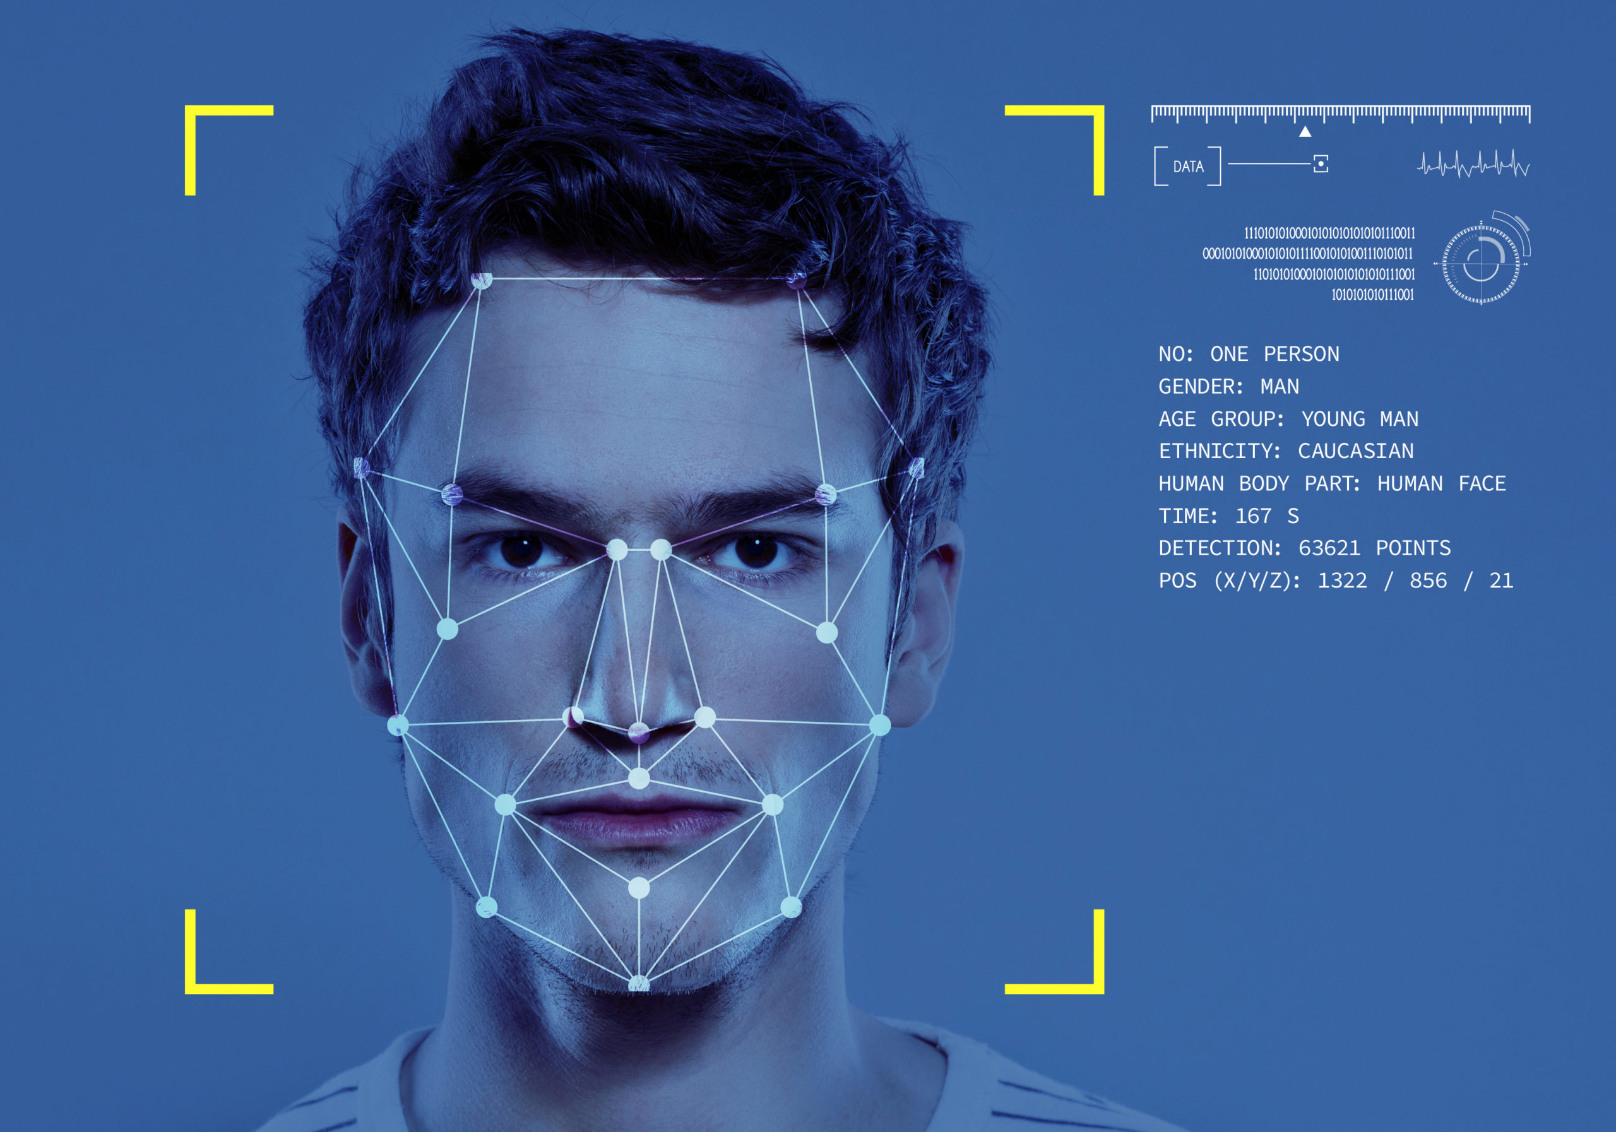


Technology Stack
Our project, SmartVerify, utilizes a robust technology stack to ensure efficient and reliable performance. The key components of our technology stack include
Viola-Jones algorithm for face detection
Python for backend development
Android platform for mobile application development

Slide 9
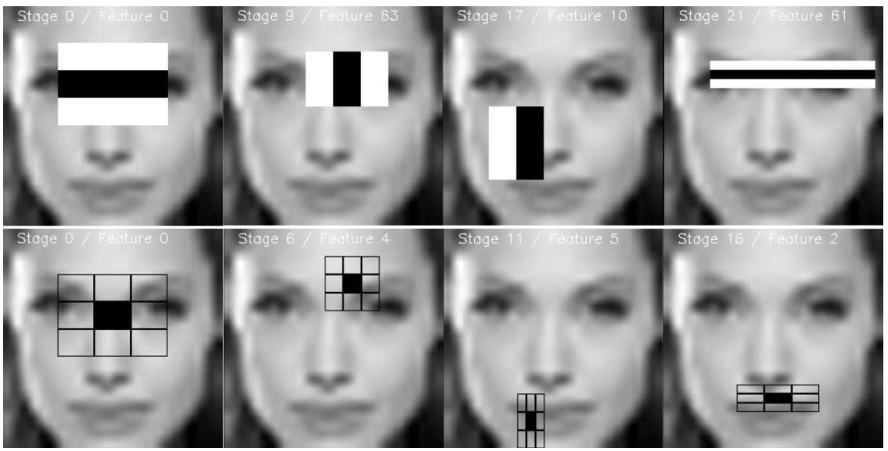
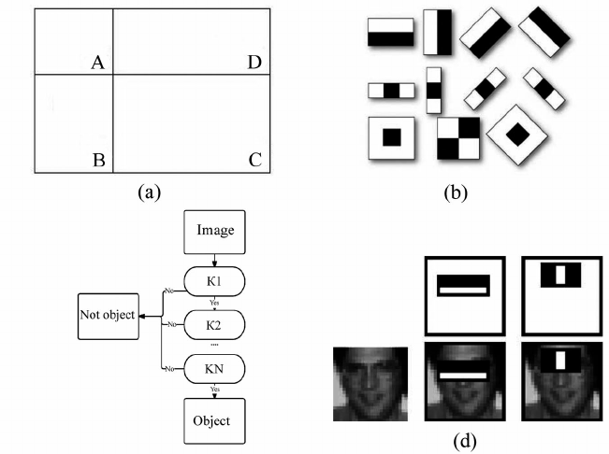
Viola-Jones algorithm
The Viola-Jones algorithm is like a super smart detective for finding faces in pictures. It works by looking for certain patterns or features that are common in human faces, such as the arrangement of eyes, nose, and mouth.
The Viola-Jones algorithm searches through a picture, checking each small area to see if it matches this puzzle piece. If it finds a match, it's likely that there's a face there!

Slide 10
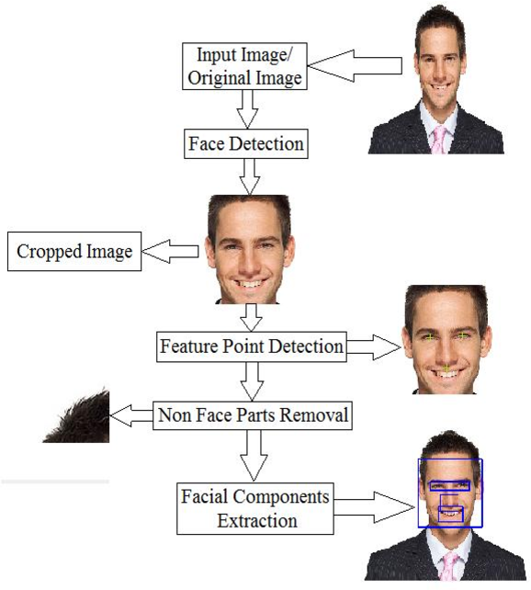
Viola-Jones algorithm

Slide 11
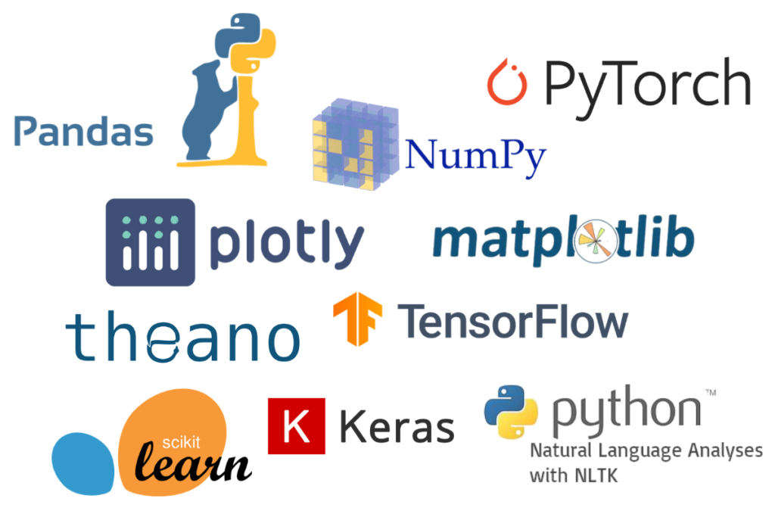
Python
Python is a simple and versatile programming language with a user-friendly syntax and extensive standard library.
Usage in AI/ML
Python's dominance in AI/ML is powered by its rich ecosystem of libraries and frameworks:
NumPy for numerical computing
Pandas for data manipulation
SciPy for scientific computing
Scikit-learn for machine learning
TensorFlow and PyTorch for deep learning.

Slide 12


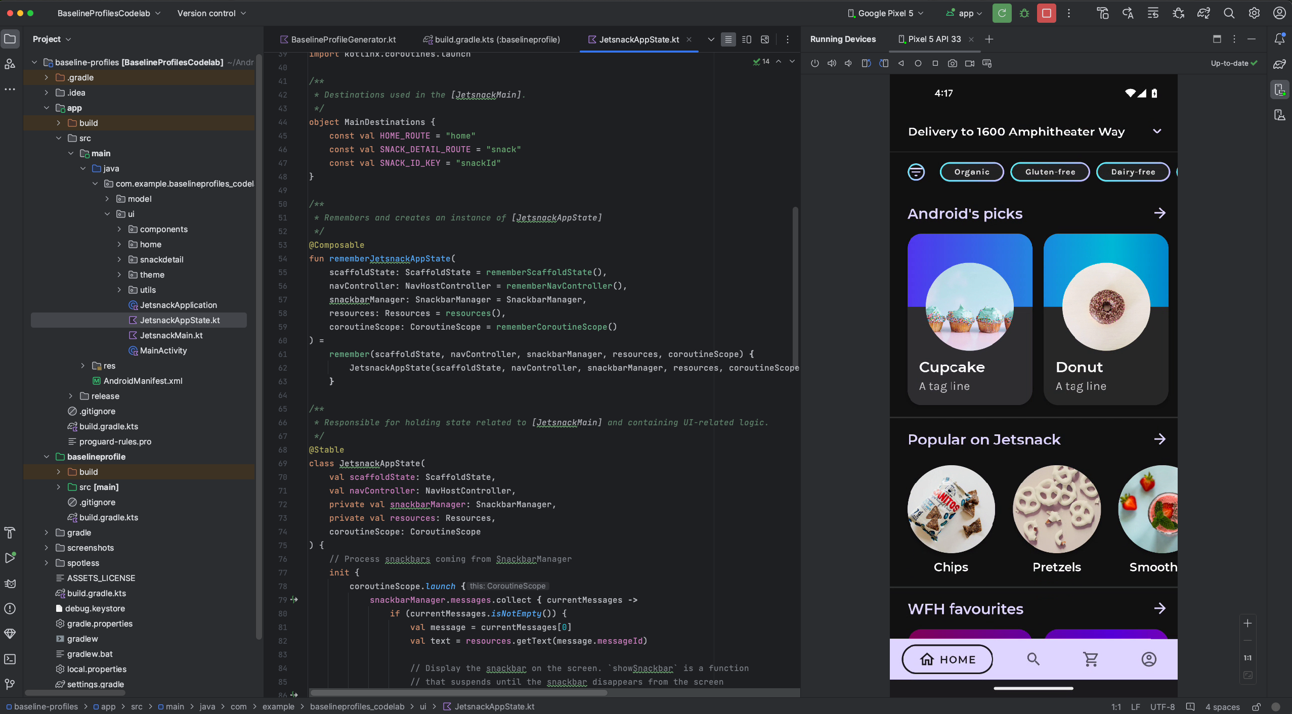
Android
Android development refers to the process of creating applications for devices running the Android operating system. With a large user base and a diverse range of devices, Android offers developers a lucrative platform for building innovative mobile applications.
Key Components
Java/Kotlin:
Java and Kotlin are the primary programming languages used for Android development.
Android Studio:
Android Studio is the official Integrated Development Environment (IDE) for Android development.
Android SDK:
The Android Software Development Kit (SDK) includes various tools, APIs, and libraries necessary for building Android applications. It provides access to device features such as the camera, sensors, location services, and more.

Slide 13



Advantages
Enhanced Security
By leveraging AI-powered face detection technology, SmartVerify enhances security measures, minimizing the risk of fraud and impersonation during exams.
Improved Accessibility
SmartVerify eliminates the need for physical hall tickets and ID proofs, ensuring accessibility for all students and reducing the chances of missed exams due to forgotten or misplaced documents.
Streamlined Process
SmartVerify simplifies the examination process by digitizing the verification of student identities, reducing the reliance on physical documents and minimizing administrative burdens.

Slide 14
Implementation flow
Register Candidate
Store candidate's face and related information in the database.
Capture candidate's face using the device's camera.
Capture Face
Face Detection
Use face detection algorithm to identify the presence of a face in the captured image.
Face Recognition
Compare the detected face with the faces stored in the database for recognition.
Result Retrieval
Retrieve the result along with relevant information after successful recognition.

Slide 15
System Requirements
System Requirements | Software Requirements
Operating System Windows 10/11 64-bit Processor and RAM Minimum Intel core i7 and 16GB RAM Mobile Device Android OS 11 and above Android smartphone minimum of 8GB RAM Camera with decent resolution for capturing clear images. Sufficient storage space for installing the application and storing captured data. Internet Connectivity Stable internet connection for downloading and updating the application. Optional but recommended for data synchronization and backend operations. | Development Tools Android Studio Hedgehog | 2023.1.1 Programming Languages Python 3 and above Java 11 and above Python Libraries and Frameworks OpenCV: Essential library for computer vision tasks, including implementing the Viola-Jones algorithm for face detection. NumPy: Used for numerical computations and efficient handling of multi-dimensional arrays, which are common in image processing tasks.

Slide 16
Demonstration

Slide 17
Conclusion
Enhanced Security: SmartVerify improves exam security by leveraging AI-powered face detection, minimizing the risk of fraud and impersonation.
Streamlined Process: The digitization of verification processes simplifies exam administration, reducing reliance on physical documents and minimizing administrative burdens.
Improved Accessibility: By eliminating the need for physical hall tickets, SmartVerify ensures accessibility for all students and reduces the chances of missed exams due to forgotten or misplaced documents.

Slide 18

Q&A

Slide 19
Thank You

